Slide 1
Autonomous Flag Finder
Burnout Squad
Jeremiah McCutcheon: Project Manager
David Koblah: Hardware Design
Michael Bates: Software Design

Slide 2
System Description
This system is an autonomous robot designed to locate, identify and retrieve flags inside a room or maze.
It will utilize a camera and proximity sensors to navigate its environment.
The camera will wirelessly communicate with a computer in order to identify flags and retrieve them.
A microcontroller will control the movement of the tank, proximity sensors and servo motors to rotate the camera or retrieve the flags.
David Koblah

Slide 3
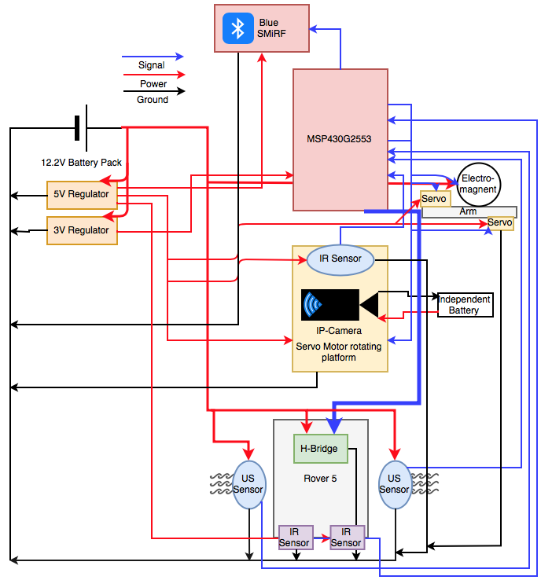
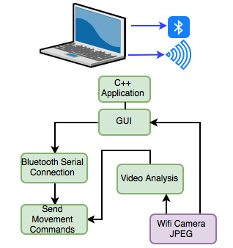
System Diagram
David Koblah

Slide 4
Division of labor
Jeremiah: Bluetooth Serial Communication Interface with Mac, Video Camera Interface with Mac, Image Processing
David: BlueSMiRF receiving communication, Servo arm and Electromagnet interface, Flag Collection
Michael: Analog IR sensor implementation, Autonomous Navigation, PCB, Budget
Michael Bates

Slide 5
Safety Concerns
Our primary safety concern this week has been managing the 9.6V battery to avoid any fires and over volting microcontroller circuits. We may also add a warning signal to our design to prevent fellow lab users from running into the rover.
Making sure not to connect to TTU with lab router.
Wearing appropriate Personal Protective Equipment
Pants
Closed Toed Shoes
Safety Glasses
David Koblah

Slide 6
Last Week’s Deliverables
Jeremiah
Implement Blob Identification✅
Begin work on navigation algorithm❌
Integrate RSSI❌
David
Finalize Complete Design of Autonomous Flag Finder✅
Integrate Robot Arm and Camera Radar Sequence❌
Assist With Miscellaneous Tasks✅
Michael
Finalize PCB✅
Get It Double Checked ✅
Create Parts List ✅
Place Orders ✅
Test and Finalize Sensor Navigation Code ❌
Michael Bates

Slide 7
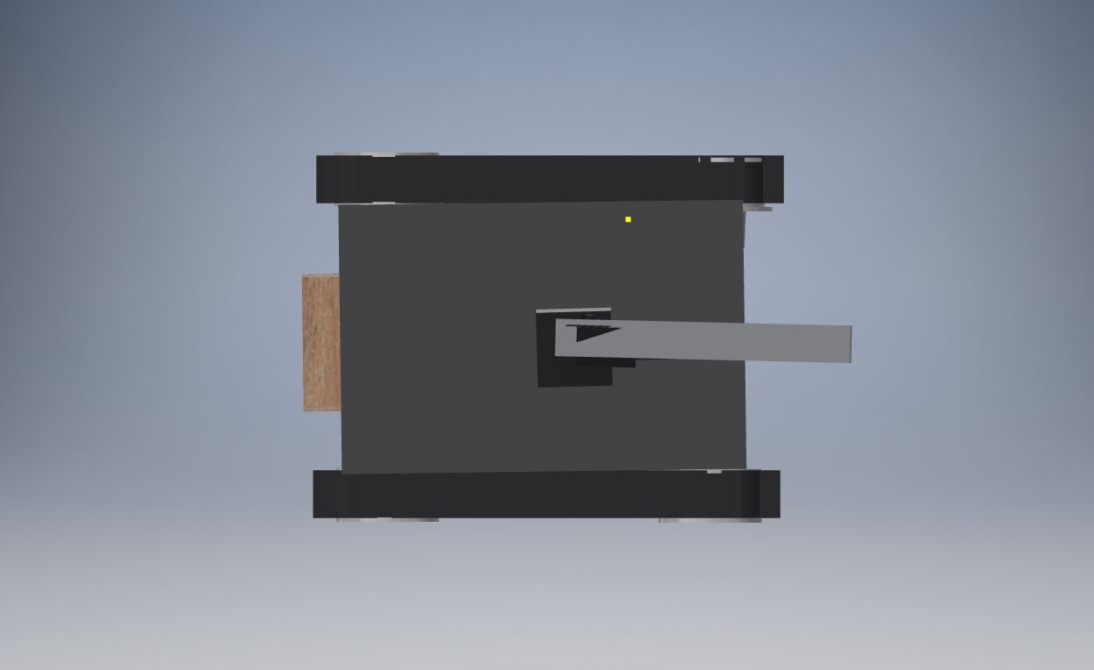
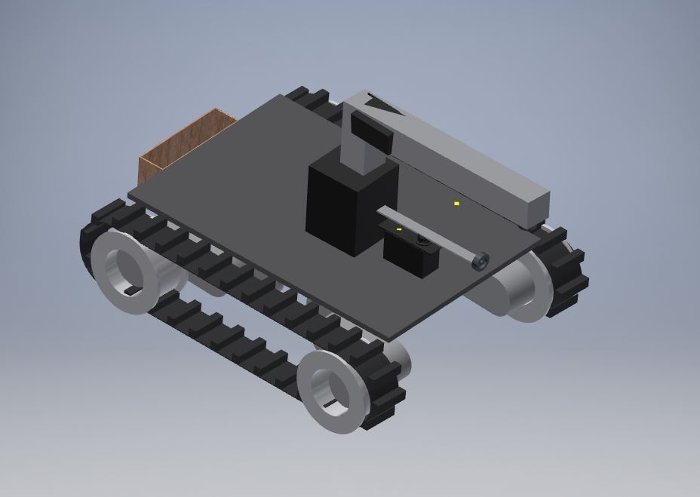
Revised Rover Design
Broader Base
Camera Servo Not Required
David Koblah

Slide 8
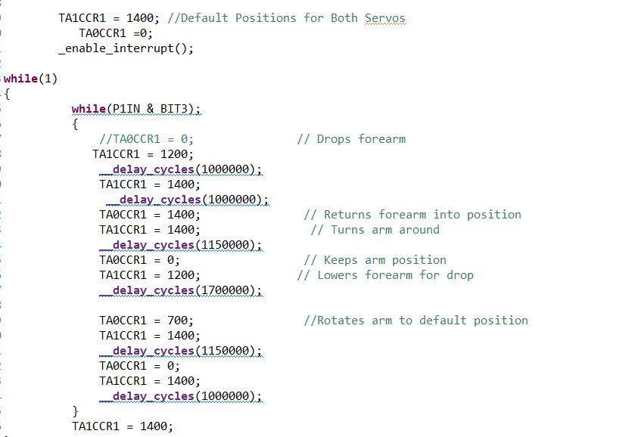
Finalized Robot Arm Sequence Code
David Koblah

Slide 9
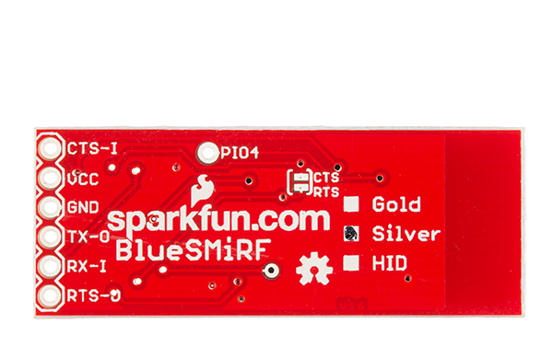
Request-To -Send & Clear-To-Send
In the traditional DTE (Data Terminal Equipment) and DCE (Data Communication Equipment) arrangement: (a) The DTE activates RTS (Request To Send) to the DCE and waits for DCE to activate CTS (Clear To Send) before DTE may send TXD to the DCE. (b) The DCE may send RXD to the DTE any time and has nothing to do with RTS/CTS.
Best Case Scenario:
(a) You simply wait for active CTS before you send TXD.
(b) You activate RTS when and only when you are capable of receiving RXD.
Sparkfun [1]
David Koblah

Slide 10

PCB Design Tips
Select “Group”
Select “Move”
Highlight Component(s) You Want To Move
Right Click Highlight
Select Move Group
Right Click Once Picked Up To Rotate
Eagle Cad [2]
Michael Bates

Slide 11
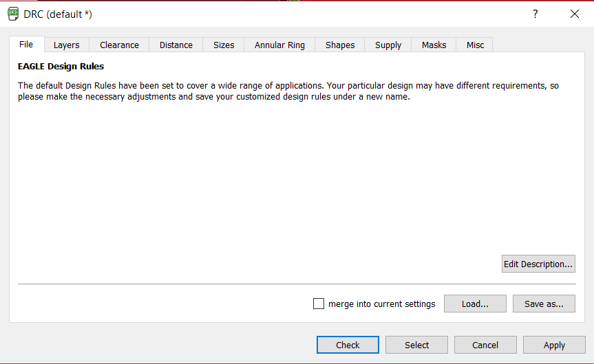

PCB Design Tips Continued
Michael Bates
Eagle Cad [2]

Slide 12
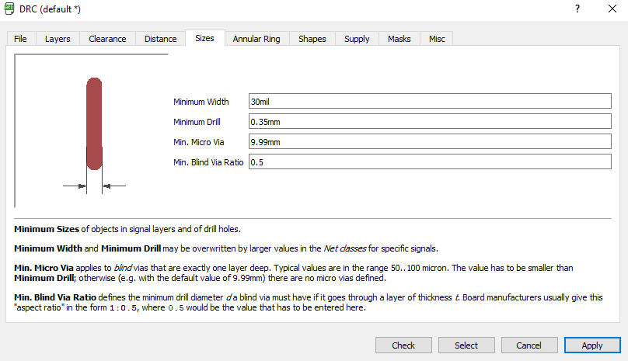
PCB Design Tips Continued
Eagle Cad [2]
Michael Bates

Slide 13
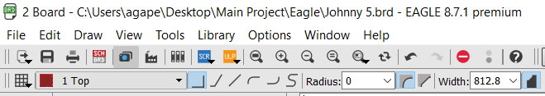
PCB Design Tips Continued
Eagle Cad [2]
Michael Bates

Slide 14
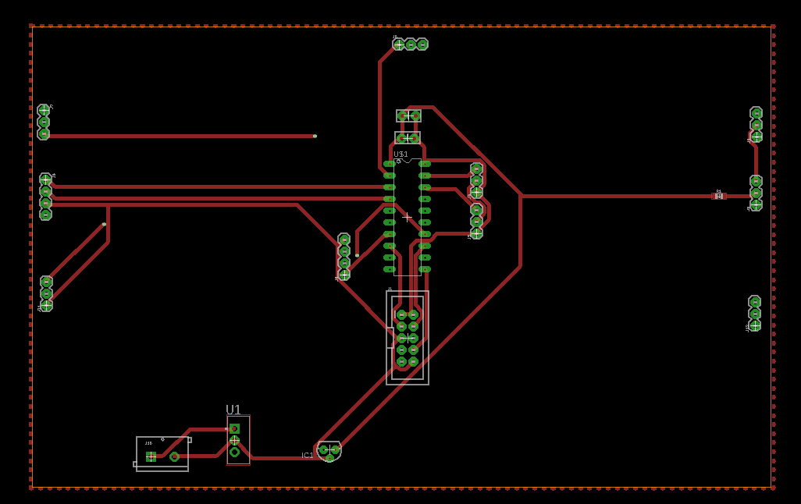
PCB Design Tips Continued
Right Click Polygon Line
Left Click Name
Change to Your Ground Name (Ex: GND)
Eagle Cad [2]
Michael Bates

Slide 15
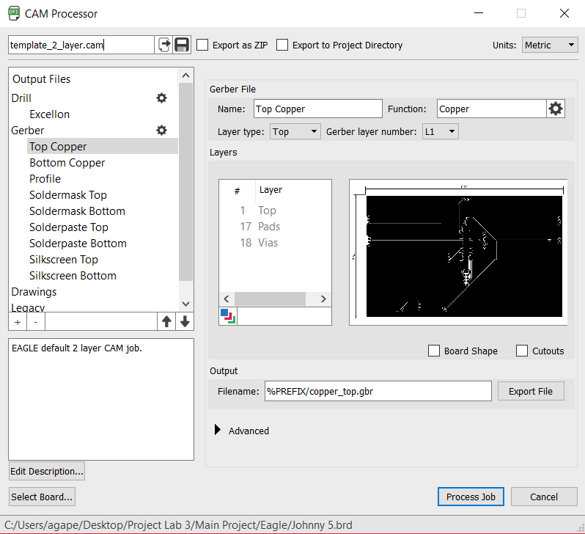
Gerber File
Select File
Select Cam Processor
Export as ZIP
Select Process Job
Eagle Cad [2]
Michael Bates

Slide 16
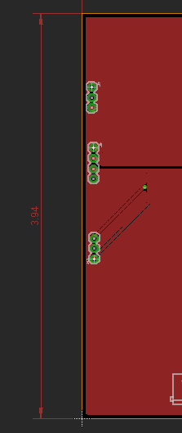
Dimensions
Right Click on Border from Center
Select Dimensions
Move out from Board Edge and Left Click To Drop
Eagle Cad [2]
Michael Bates

Slide 17

Advanced Circuits Website
Fill in Email
Choose File
Select Gerber Zip File
Upload Zip File
Michael Bates
Advanced Circuit [3]

Slide 18
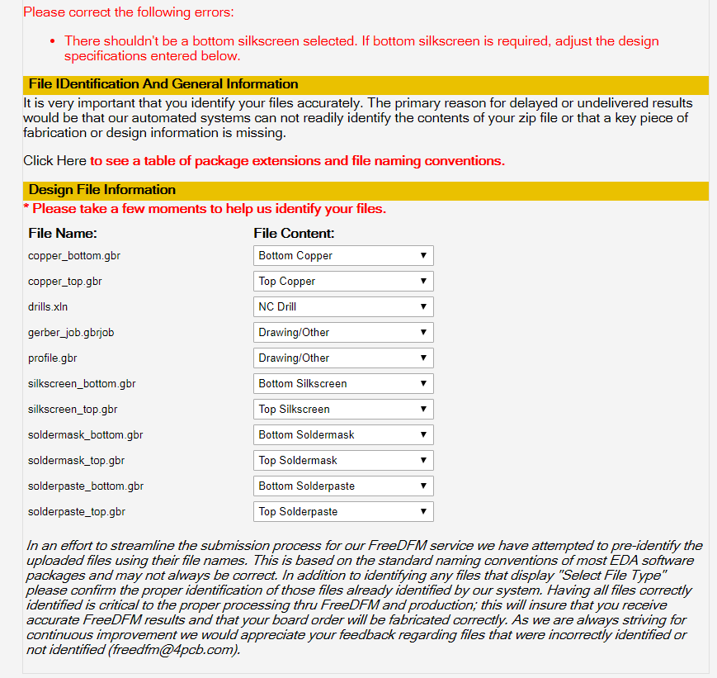
Advanced Circuits Website Continued
Match File Name to Filetype
Select Drawing/Other for job and profile
Michael Bates
Advanced Circuit [3]

Slide 19
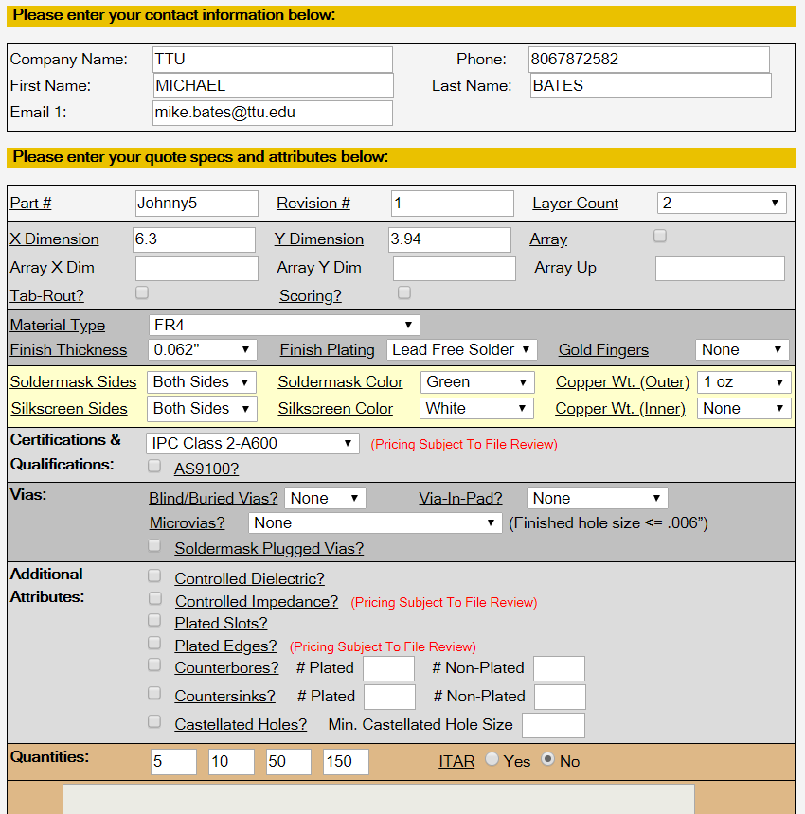
Advanced Circuits Website Continued
Fill in Top Info
Create any Part# Name
Revision# 1
Number of Layers for Your PCB
Dimensions in Inches
Select “NO” for ITAR
Submit
Advanced Circuit [3]
Michael Bates

Slide 20
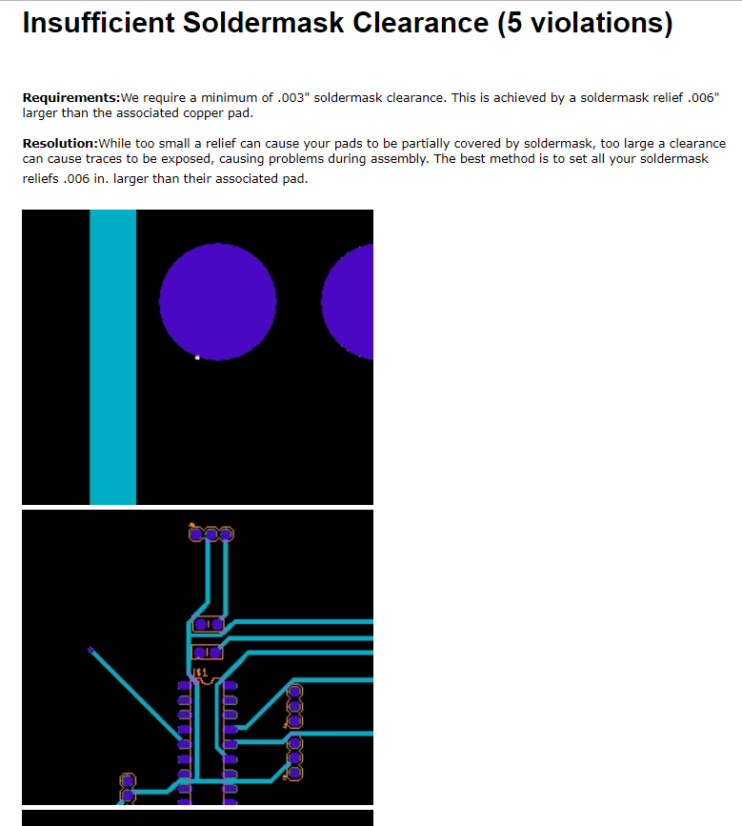
Emailed Response with Links
Michael Bates
Advanced Circuit [3]

Slide 21
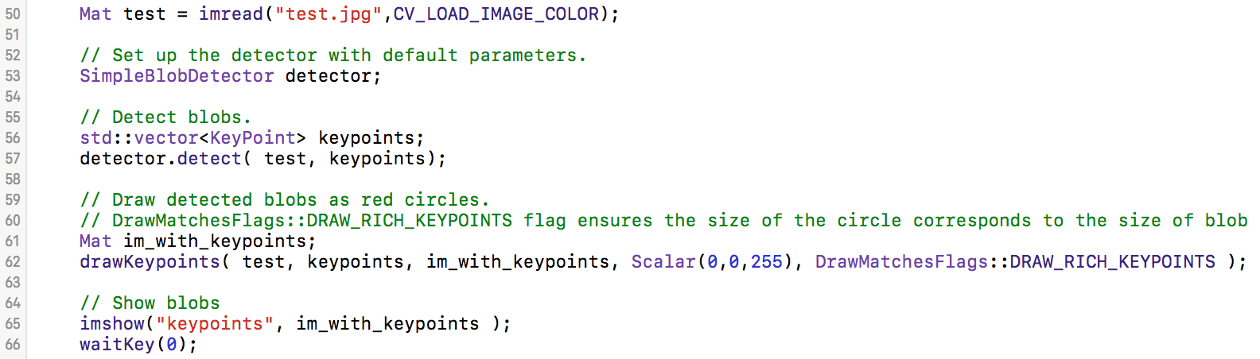
Blob Detection
Load Image in color
Seek out high density points
Draw a circle and display loaded image
Jeremiah McCutcheon
LearnOpenCV.com [4]

Slide 22
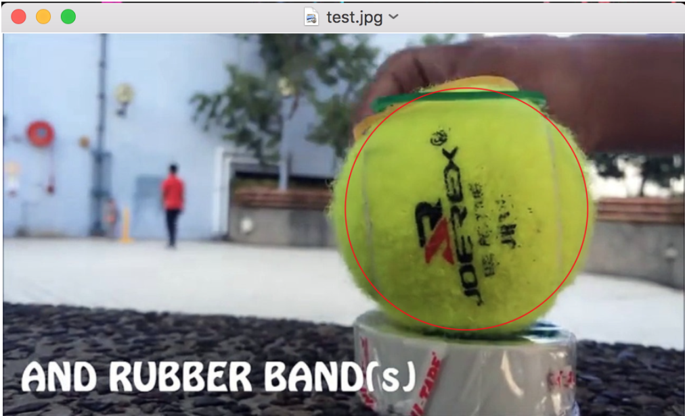
Testing Blob Detection
Jeremiah McCutcheon
Image for blob detection testing [5]

Slide 23

Increasing Efficiency
Spent most of the week on multithreading
Needed to not rebuild all visual elements every loop
Jeremiah McCutcheon

Slide 24
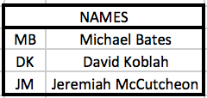
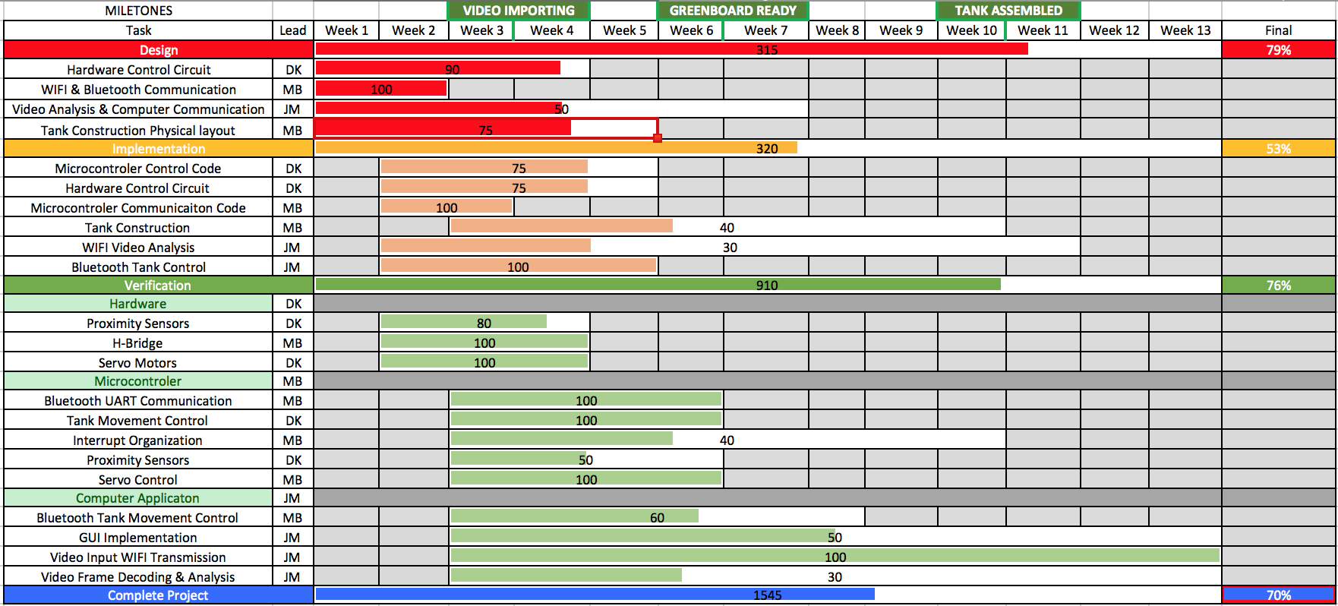
Gantt Chart
Jeremiah McCutcheon

Slide 25
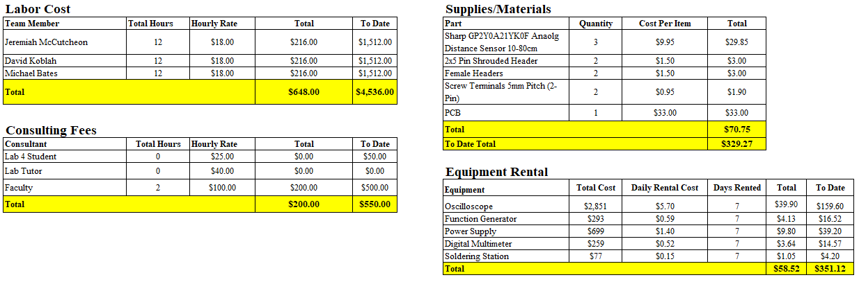
Budget
Michael Bates

Slide 26
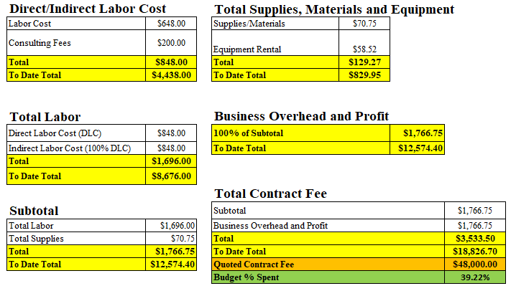
Budget Continued
Michael Bates

Slide 27
Next Week’s Deliverables
Jeremiah
Complete Blob Detection
Integrate RSSI Signal
Write ‘Blob Mode’ Code
David
Build Flags For Blob Testing
Integrate Electromagnet into Robot Arm
Sample and Integrate RTS/CTS Into Flag Finder System
Michael
Add ADC10 Code for Analog IR Distance Sensors
Run Tests with Analog IR Distance Sensors
Create Distance Values Datasheet For Sensor Readings
David Koblah

Slide 28
References
[1] Sparkfun Bluetooth Module https://www.sparkfun.com/products/12577
[2] Autodesk Eagle Version 8.7.1, Autodesk Inc., 2018
[3] Advanced Circuits Free DFM, Printed Circuit Board Design Check https://www.my4pcb.com/net35/FreeDFMNet/FreeDFMHome.aspx#_ga=2.187173032.1802782904.1522290684-1684309231.1522290684
[4] LearnOpenCV.com: https://www.learnopencv.com/blob-detection-using-opencv-python-c/
[5] Random image for blob testing: http://www.dailymotion.com/video/x2hh0x0
Michael Bates

Slide 29
Questions?

